Slide 1
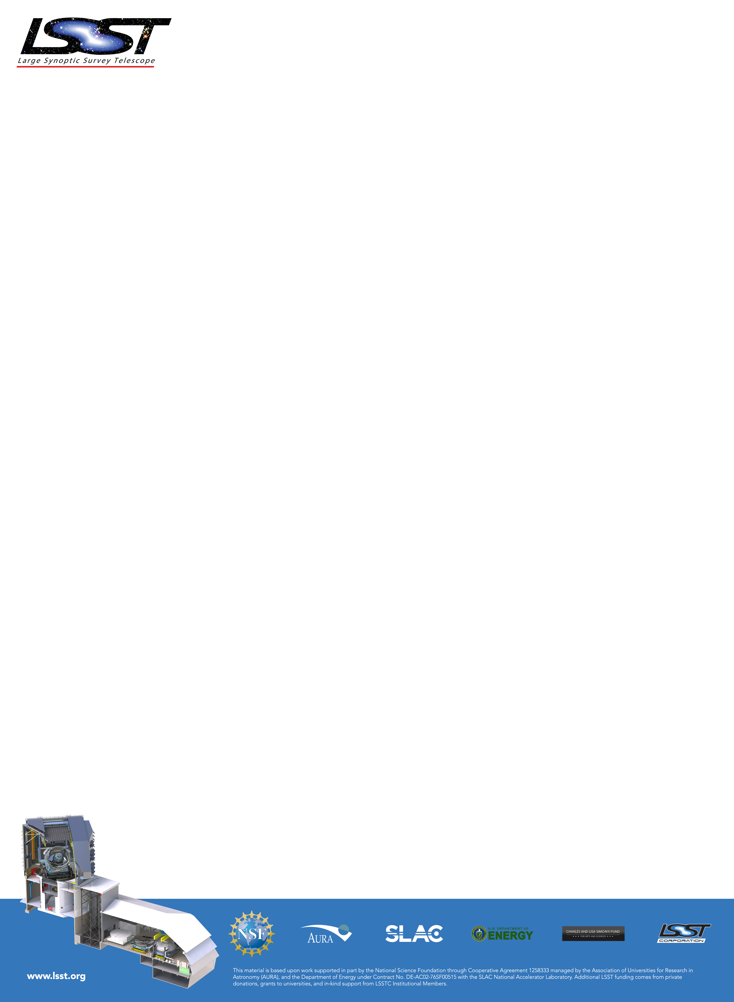
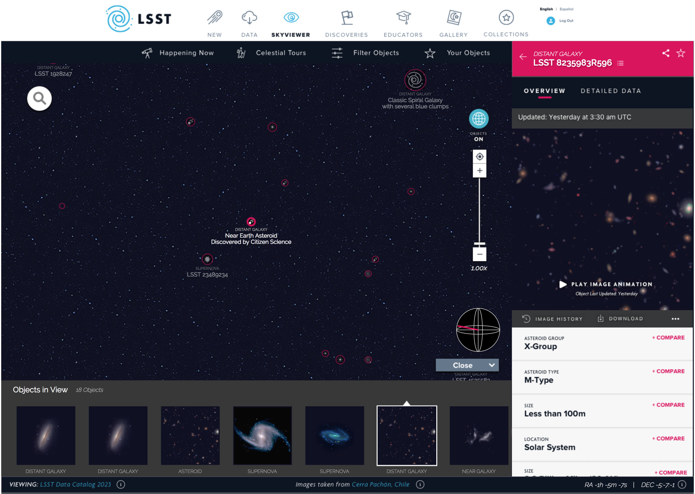
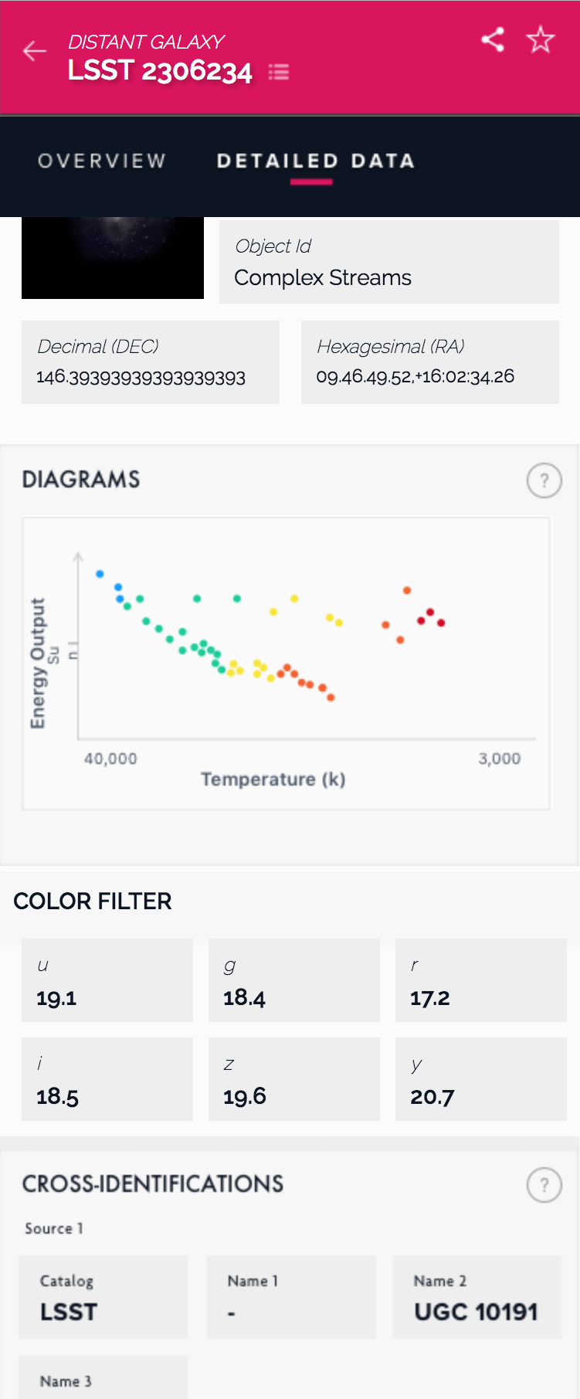

Skyviewer Investigations for LSST EPO J. Matt Peterson (AURA/LSST, Tucson), Dr. Amanda E. Bauer (AURA/LSST, Tucson), Ben Emmons (AURA/LSST, Tucson), Ryan Bruner (TNSD⁺), Jimmy Watkins (TNSD⁺), Tom Gonzalez (TNSD⁺), Paula Wellings (TNSD⁺)
6
Detail View
Introduction
5
LSST Education & Public Outreach (EPO) reports on the early investigations of using and implementing a skyviewer across its software systems. We research available open-source skyviewer software and identify requirements and possible features for our implementation. Over the summer we prototyped an implementation of this using Aladin and Aladin-lite.
Independent of the prototyping we contracted design work and user experience testing from Theresa Neil: Strategy & Design (TNSD) which resulted in user interface features.
4
2
3
1
Requirements
The skyviewer has three software engineering requirements.
Build on an existing sustainable open-source project.
Simple to extend and integrate with existing tools and libraries.
Usable in multiple contexts.
User Interface
Features
EPO contracted design work and user experience testing from TNSD. Through this user experience testing TNSD identified weaknesses with existing Skyviewer design and iteratively improved the design. The above mockup is the result. Some specific features are a gallery, object and detail slider, search, filters and the ability to create collections.
Gallery
Object slider
Detail slider
Search
Filters
Collections
Implementation
Conclusion
Aladin v10.009 and Aladin Lite were used to create a prototype survey with HSC Public Data Release 1 UDEEP data (3.5 sq. deg.). This was reprocessed by the LSST DM team using the LSST DM pipeline. It took 16 hours using 8 vCPUs and 16 GB of RAM to process 127 GB of calibrated exposure fits images across three bands (irg) into 16.7 GB HiPS color png image survey (Norder=3,12).
Aladin and Aladin Lite use HEALPix. It is supported in multiple libraries in Python 3, which has seen extensive use at LSST and is used in our science notebook investigations. HiPS and MOC, which use HEALPix, are IVOA standards we plan to support. Finally, HEALPix is acceptable for use with the LSST science platform and our formal education teams.
EPO plans to implement this as modular open-source software components. Components should be reusable for different audiences through configuration and extension. Components will be used by our portal and science notebook systems. Since our science notebook system will extend the LSST DM science platform, our components will be available to LSST scientists.
Though we plan to use Aladin and Aladin Lite, some improvements are required. Aladin Lite and HiPS do not support dynamic image creation using individual bands.
Comparison
We investigated using three types of skyviewers. Aladin and Aladin Lite, World Wide Telescope (WWT) and Leaflet based skyviewers.
 | Aladin & Aladin-lite | Leaflet based skyviewers | World Wide Telescope
Projection | HEALPix | Mercator | TOAST
Tile Manager | HiPS | Leaflet | WWT
Tile Creation | Aladin | ImageMagick, custom | Montage
Examples | ESA¹, CDS², DES³, LIGO | DECaLS⁴, CFHTLS⁵, HSC-SSP⁶, NASA, SDSS | WWT web client
More Information
LSST Science Book, arXiv:0912.0201
LSST EPO Design LEP-31, http://ls.st/7ex
Science Platform Design, https://ldm-542.lsst.io/
Aladin Lite, Bibcode:2014ASPC..485..277B
HEALPix, Bibcode:2007MNRAS.381..865C
IVOA HiPS Standard, http://www.ivoa.net/documents/HiPS/
IVOA MOC Standard, http://www.ivoa.net/documents/MOC/
HSC Data Release 1, arXiv:1702.08449
ESA, European Space Agency
CDS, Centre de Données astronomiques de Strasbourg
DES, Dark Energy Survey
DECaLS, DECam Legacy Survey
CFHTLS, Canada-France-Hawaii Telescope Legacy Survey
HSC-SSP, Hyper Suprime-Cam Subaru Strategic Program
⁺ Theresa Neil: Strategy + Design, http://www.theresaneil.com/

